Slide 1
Secure Data Hiding in Image Using Steganography
CAPSTONE PROJECT
Presented By
Student Name : SUBHAM RAJESHBHAI CHAURASIYA
College Name : GOVERNMENT POLYTECHNIC, VALSAD
Department : INFORMATION TECHNOLOGY

Slide 2
OUTLINE
Problem Statement
Technology used
Wow factor
End users
Result
Conclusion
Git-hub Link
Future scope

Slide 3
Problem Statement
Create a python program to securely embed a text message into an image by manipulating its pixel values and enable retrieval only with a correct passcode.
Ensure that the program can handle edge cases like missing image files or messages exceeding the image's capacity, while maintaining a simple user interface and supporting encryption and decryption.

Slide 4
Technology used
Python Programming Language
OpenCV library for image processing
Dictionary data structure for character encoding and decoding
OS module for file handling

Slide 5
Wow factors
Hides a secret message invisibly in an image, which can only be retrieved with a passcode.
Simple yet effective encryption without altering the visible quality of the image.
Lightweight and easy-to-use code

Slide 6
End users
Individuals or organizations looking for basic, image-based steganography solutions.
Students and beginners exploring encryption and data hiding techniques.

Slide 7
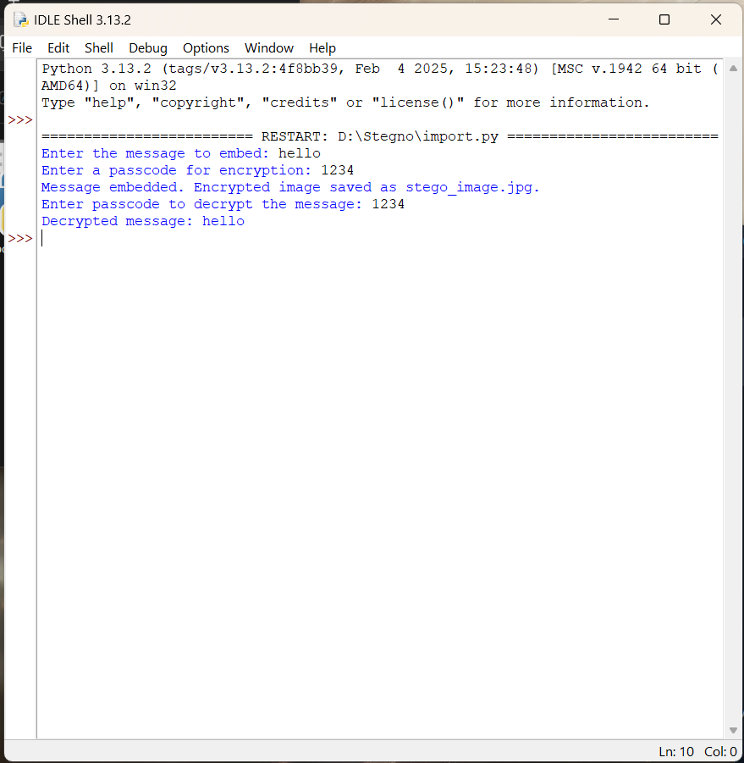
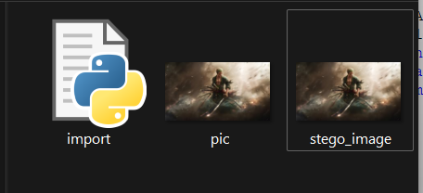
Results

Slide 8
Conclusion
The project demonstrates the use of Python and OpenCV for embedding hidden messages in images. It highlights basic encryption techniques and ensures user-friendly functionality.

Slide 9
GitHub Link
LINK: https://github.com/Subhuu/Stegno.git

Slide 10
Future scope(optional)
Implementing advanced encryption techniques for added security.
Extending support for more image formats and larger messages.
Creating a graphical user interface (GUI) for non-technical users.
Exploring compression to reduce file size after embedding.

Slide 11
THANK YOU

